Slide 1
Lecture 1 : Introduction
Nisar Ahmed Siddiqui

Slide 2
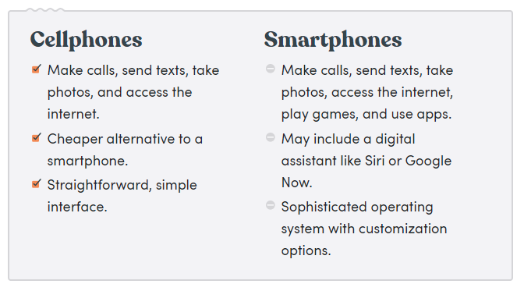
Smartphone?

Slide 3
Mobile OS
An OS much like Linux, windows or MAC to control your mobile device.
Types:
Android
IOS
BADA (Samsung)
Windows Mobile
Blackberry OS
Palm OS (PDA)
Symbian (Nokia)

Slide 4
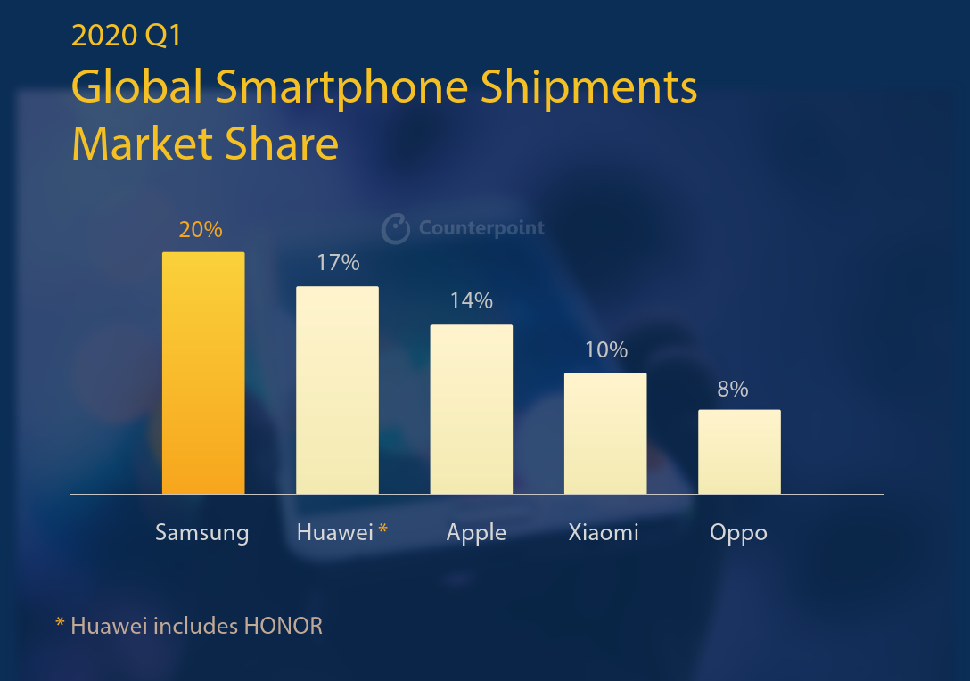
Market Share

Slide 5
Why MAD?
In 2020, mobile apps are projected to generate $188.9 billion in revenue via app stores and in-app advertising. What’s more, enterprise mobility is estimated to be worth $510.39 billion by 2022.
USA proclaimed to completely remove physical banking system and move towards mobile banking system by 2025.
Steep incline in the usage of mobile phones in the last few years.

Slide 6
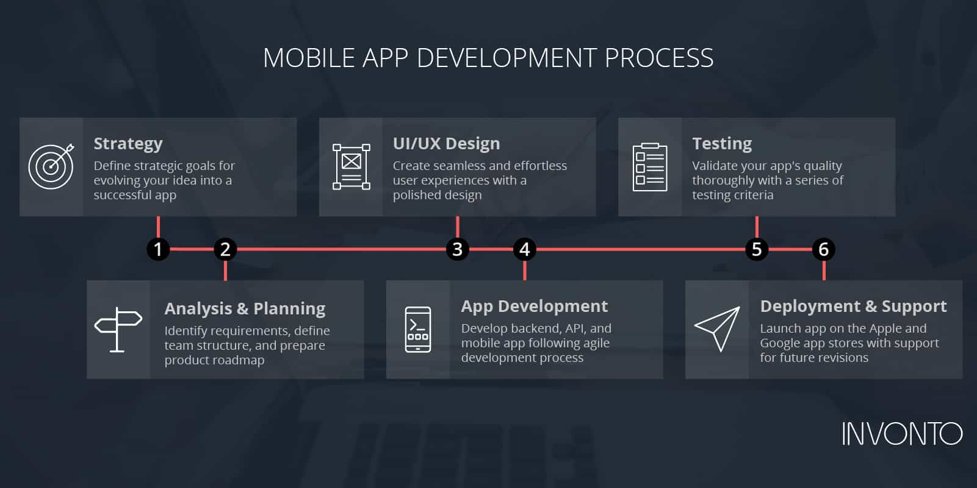
Mobile App Development Process

Slide 7
1. Strategy
In this phase, you will:
Identify the app users
Research the competition
Establish the app’s goals and objectives
Select a mobile platform for your app
Notes:
The first phase of the mobile app development process is defining the strategy for evolving your idea into a successful app. You may include a more significant part of this in your overall enterprise mobility strategy. As one app’s objectives may differ from another, there is still an app-specific impact to the mobility strategy to address during the development process.

Slide 8
2. Analysis and Planning
Analysis and planning begin with defining use cases and capturing detailed functional requirements.
After you have identified the requirements for your app, prepare a product roadmap.
This includes prioritizing the mobile app requirements and grouping them into delivery milestones.
Part of the planning phase includes identifying the skills needed for your app development initiative

Slide 9
3. UI / UX Design
The purpose of an app’s design is to deliver seamless and effortless user experiences with a polished look.
There are many techniques used to create effective App Design
Information Architecture & Workflows
Wireframes
Style Guide
Mockups
Prototype
Notes:
The success of a mobile app is determined based on how well users are adopting and benefiting from all its features. The goal for mobile app UI / UX design is creating excellent user experiences making your app interactive, intuitive, and user-friendly. While polished UI designs will help with early adoption, your app must have intuitive user experiences to keep app users’ engaged
Information Architecture & Workflows
The first step of your mobile app design process is to determine the data your mobile app will display to the users, the data it will collect, user interactions with the finished product, and the user journeys within the app.
For companies, enterprise mobile solutions have users with different roles and privileges, and it is essential to incorporate these rules as part of your app’s information architecture. Workflow diagrams help identify every possible interaction a user has with the app and the app’s navigation structure.
Wireframes
Mobile app designers often start app design with sketches on paper. Wireframes are the digital form of sketches. Wireframes are conceptual layouts, also referred to as low-fidelity mockups—they give visual structure to your app’s functional requirements.
With wireframes, the focus is more on aesthetics and user experience, not on color schemes and styles. Creating wireframes is a quick and cost-effective approach for designing app layouts and iterating through them in the design review process. While creating wireframes you should consider device specific design. So whether your app is used on iPhone, iPad, or Android phone and tablets; it provides intuitive and device specific user experiences.
Style Guide
Style guides are “living documents” where an app’s design standards from your company’s branding rules down to the navigation icons, are documented.
Style guides include:
What font family will your app’s text use?
What will the color scheme be?
How will your company brand be reflected in the app design?
Style guides contribute to an app’s design strategy. Establishing a style guide early on as part of your mobile app development process improves the productivity of your mobile app developers. At the same time, following a style guide will help keep your app’s look and feel consistent. As part of your app design, you should consider app design guidelines from Apple for iOS app and from Google for Android apps.
Mockups
Mockups, or high-fidelity designs, are the final renderings of your app’s visual design. Mockups are created by applying your style guide on to the app wireframes. As your app’s design begins to finalize, expect further modifications to its information architecture, workflow, and aesthetics. Adobe Photoshop is the most popular tool for creating high-fidelity mockups.
Prototype
While mockups display your mobile app’s functionality using static designs, these can turn into click-thru prototypes with tools like Invision and Figma. Prototypes are highly useful for simulating the user experience and the app’s workflows expected from the finished product. While prototype development can be time-consuming, the efforts are well worth it, as they offer early-stage testing of your app’s design and functionality. Often, prototypes help identify modifications to the app’s proposed functionality.
Some companies prefer even doing prototypes at a wireframing stage, especially when an app’s functional requirements are not well thought out. Or, there is a need to review the app’s proposed functionality with a focus group.

Slide 10
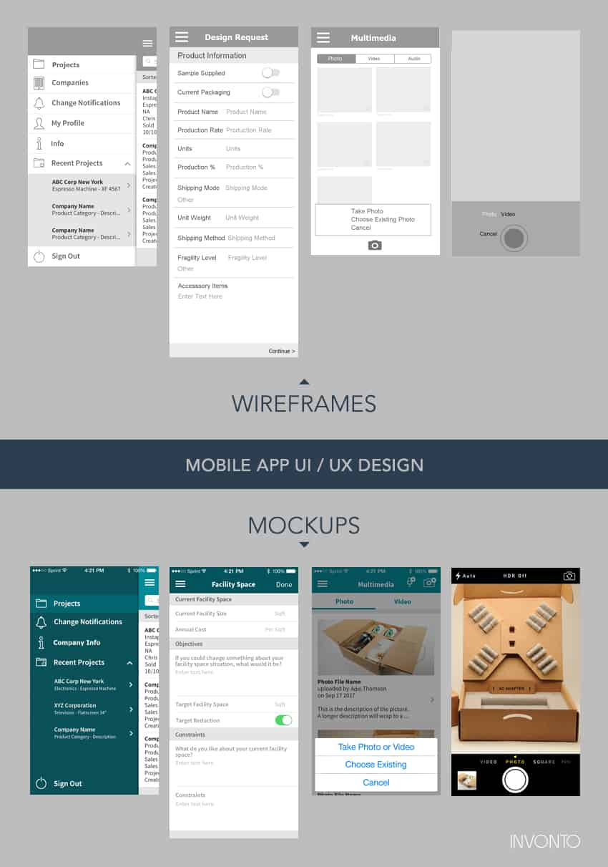

Slide 12
4. App Development
Planning remains an integral part of this phase in the mobile app development process. Before actual development/programming efforts start, you will have to:
define the technical architecture,
pick a technology stack, and
define the development milestones.
A typical mobile app project is made up of three integral parts: back-end/server technology, API(s) and the mobile app front-end.
Notes:
Back-End/Server Technology
This part includes database and server-side objects necessary for supporting functions of your mobile app. If you are using an existing back-end platform, then modifications may be needed for supporting the desired mobile functionality.
API
An Application Programming Interface (API) is a method of communication between the app and a back-end server/database.
Mobile App Front-End
The front-end is the native mobile app an end-user will use. In most cases, mobile apps consist of interactive user experiences that use an API and a back-end for managing data. In some cases, when an app needs to allow users to work without internet access, the app may utilize local data storage.
You can utilize almost any web programming language and databases for the back-end. For native mobile apps, you have to choose a technology stack required by each mobile OS platform. iOS apps can be developed using Objective-C or Swift programming language. Android apps are primarily built using Java or Kotlin.
There is more than one programming language and technology stack for building mobile apps —the key is picking a technology stack that is best suited for your mobile app.
Mobile technologies advance much faster with new versions of mobile platforms. Furthermore, new mobile devices are released every few months. With platforms and devices rapidly changing, agility is essential for building mobile apps within timelines and budgets. If time-to-market is a priority, use an agile development approach. This approach supports frequent software releases with completed functionality. Defining development milestones as part of the agile development plan supports developing your mobile application in iteration.
As each development milestone completes, it is passed on to the app testing team for validation.

Slide 13
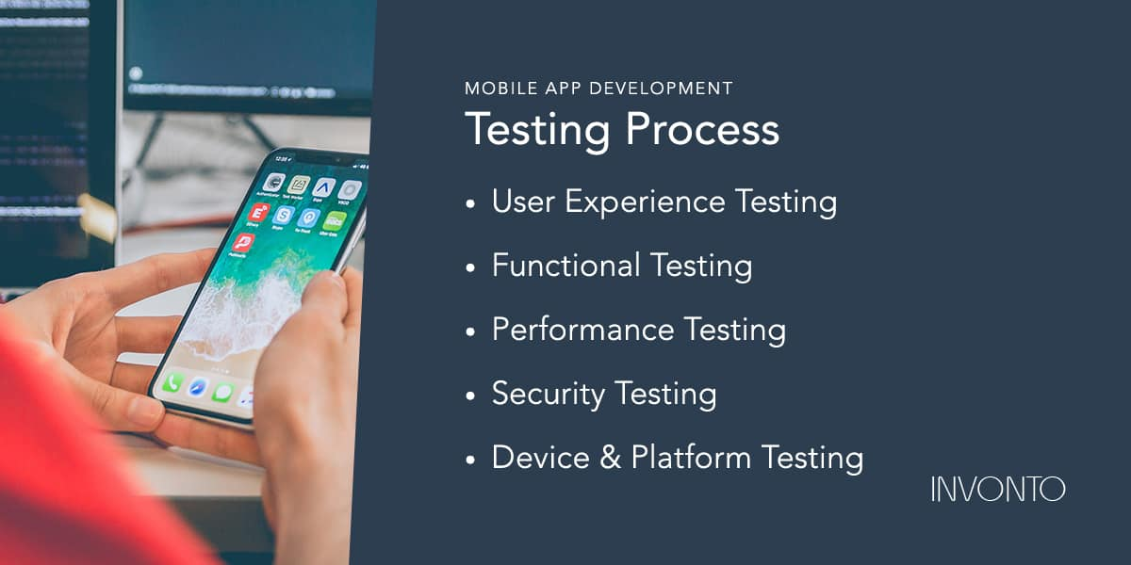
5. Testing
Notes:
Testing
Performing thorough quality assurance (QA) testing during the mobile app development process makes applications stable, usable, and secure. To ensure comprehensive QA testing of your app, you first need to prepare test cases that address all aspects of app testing.
Similar to how use cases drive the process of mobile app development, test cases drive mobile app testing. Test cases are for performing test steps, recording testing results for software quality evaluation, and tracking fixes for retesting. A best practice approach is involving your QA team in the Analysis and Design stages. The familiarity with your app’s functional requirements and objectives will help produce accurate test cases.
Your app should undergo the following testing methods, to deliver a quality mobility solution.
1. User Experience Testing
A critical step in mobile app testing is to ensure that the final implementation matches the user experience created by the app design team. Visuals, workflow, and interactivity of your app are what will give your end users first-hand impression of your app. Make sure that your app employs consistent fonts, style treatments, color scheme, padding between data, icon design, and navigation. Ensuring that your app matches the original design guidelines will have a direct impact on its user adoption!
2. Functional Testing
The accuracy of your mobile app functionality is critical to its success. It’s difficult to predict every end user’s behavior and usage scenario.
The functionality of your app should be tested by as many users to cover as many potential testing conditions as possible. You might be surprised to catch bugs when two different users test the same feature but get varied outcomes. For example, both users can fill out the same form, but they both might enter different data—which could lead to discovering a defect.
3. Performance Testing
There are many quantitative criteria to use for measuring the performance of your app.
How well is your app responding to the user requests?
How fast are the app’s screens loading?
Is your app draining the phone battery or causing memory leaks?
Does your app leverage network bandwidth efficiently?
Is the size of your app bigger than what it should be?
4. Security Testing
Security is of utmost concern for enterprise mobile apps. Any potential vulnerability can lead to a hack. Many companies hire outside agencies to perform thorough security testing on their applications. Your QA and development teams can take a few simple measures to make your app secured.
If your app requires users to log in, these log in sessions should be tracked on the device and the backend. User sessions should be terminated by the system when a user has remained idle for an extended time (typically ten mins or less on a mobile app). If your app stores user credentials on the device to make it convenient for them to re-login, then you must ensure using a trusted service. For example, iOS provides the Keychain feature that can be used for storing a user’s account details for a specific app.
Data entry forms within your mobile app should be tested to ensure there is no data leakage.
5. Device and Platform Testing
On average, new mobile devices enter the market every 12 months with new hardware, firmware, and design. Mobile operating systems are updated every few months.
Multiple mobile device manufacturers like Samsung, LG, HTC, Motorola use the Android platform, but they customize the platform for their mobile devices (since Android is open source). The devices come in different sizes and shapes.
Compare that to Apple, which has a lot more controlled environment, since they control both hardware and the OS. However, there are multiple iPhone & iPad (Apple iOS) devices out on the market
This is where testing during the mobile app development process differs significantly from web app testing. You can get away by testing your web app just on the Chrome browser in a Windows environment. But your mobile app has to be tested on multiple mobile devices or device simulators to ensure smooth working of your app for all users.
The complexity of mobile app testing on all mobile devices, ongoing support costs, and headaches of mobile device management are primary reasons why companies tend to build their enterprise mobile apps for a single mobile platform (and often provide mobile devices to their users). In our experience, most companies tend to develop their enterprise mobile app first with Apple’s iOS mobile platform; only where needed they build an app for the Android platform.
Testing is imperative to an app’s future success; it encompasses a substantial section of our overall mobile app development process. Having a comprehensive mobile testing strategy is a must for delivering a quality mobile app.
During the testing phase, there are many ways for distributing your app development builds to the testers. The most common approach with iOS apps is using the Testflight and for Android apps via email or Over The Air (OTA) installs

Slide 14
6. Deployment & Support
An app’s release in the app store requires preparing metadata including:
Your app’s title
Description
Category
Keywords
Launch icon
App store screenshots
Notes:
Once submitted in the Apple App Store, iOS apps go through a review process which may take from a few days to several weeks depending on the quality of your app and how closely it follows Apple’s iOS development guidelines. If your app requires users to log in, then you will need to provide Apple with a test user account as part of the release process.
There isn’t any review process with Android apps, and they become available in the app store within a few hours of submission.
After your app becomes available in the app stores, monitor its usage through mobile analytics platforms and track Key Performance Indicators (KPIs) for measuring your app’s success. Frequently check crash reports, or other user reported issues.
Encourage users to provide your company with feedback and suggestions for your app. Prompt support for end-users and frequently patching the app with improvements will be vital to keeping users engaged. Unlike web apps where patch releases can be available to app users instantly, mobile app updates will have to go through the same submission and review process as the initial submission. Moreover, with native mobile apps, you have to continually stay on top of technology advancements and routinely update your app for new mobile devices and OS platforms.

Slide 15
Why Android?
Wider Pool of Customers
Greater Innovative Potential
Easier Installation
Easier Entry to Market
Compatible with More Devices
Easier to Learn (For Developers)
Lower Development Cost (OS Perspective)
Notes:
1. App Annie says that in 2016, 90 billion Android apps were downloaded. In the same year, the number of iOS apps downloaded counted to about 25 billion. Since Android apps run on a larger number of devices compared to their iOS counterparts, the math dictates that an Android app has access to a larger pool of customers. Paid apps can generate higher profits, and free ones can expect more downloads and reach. Hence, it makes sense to choose a mobile application development platform that focuses on Android app development.
2. Google’s philosophy of innovation and freedom filters into the apps that it hosts on its store. Being its brainchild, Android is just a lot more fun to play around with. It’s policy for including apps is a lot more flexible, which allows developers more space to experiment and innovate. Choosing a mobile application development platform for Android encourages new ideas, and is instrumental in creating applications that add previously unmatched value into users’ lives
3. You can download an Android app from any website, not just Google Play Store. In addition to the Google Play Store, apps can be hosted on third-party website. Android’s software development kit allows this, as well as the ability to install the app on the device directly, or from the command line. All of this makes the app available to a larger number of users and is a major reason to invest in an Android app development platform.
4. To develop an Android app, all you have to do is register yourself as a developer, create your Android Package Kit (APK) and submit it to the Android mobile application development platform. This is infinitely simpler than getting yourself registered as an iOS App developer, mainly because the process of securing approval from Apple involves more number of steps. Android apps are often approved and deployed in a day. While on the App Store, this takes about a few weeks. An app can also be updated on Google Play Store as many times as desired, in accordance with user feedback. On the App store, you have to submit an update and go through a process that slightly more through a time-consuming process. Android obviously wins in terms of efficiency. With the right mobile application development platform, you can get started right away!
5. The reason Android rules the app market is its ability to run on more devices than its competitors. Manufacturers that make devices supporting Android apps outnumber those developing to suit iOS specific apps. The simple reason being that an Android device will be used by more number of people, owing to the ‘affordability’ part. Thus, Android application development proved to be the wiser and a more profitable option.
6. Android is a platform that is easier to master for developers having varying skill levels. Mobile app development services can utilize Android with much greater ease than any other platform. Android uses Java which is a programming language that most developers are intimately familiar with. In case of iOS applications, one has to pick up Objective-C or Swift, Apple’s development language. Both the languages are useful for only those developing iOS apps. For Android app development, you do not need to hire scarce, expensive talents having specific technical experience for a good number of years. Even amateur developers with the requisite innovation can teach themselves to create excellent apps on Android.
7. For a subscription to the Google Play Store, one has to make a one-time payment of $25. For one to Apple’s App Store, one has to pay $99 yearly. Android is also open source, and easier to pick up. This gives it a decided edge over iOS when developers have to choose. A mobile application development platform that emphasizes apps for Android will lower the costs of the entire process to a significant degree.

Slide 16
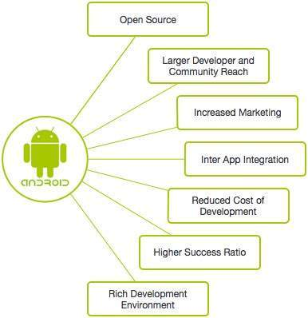
Android

Slide 17
Introduction
Android is an open source and Linux-based Operating System for mobile devices such as smartphones and tablet computers. Android was developed by the Open Handset Alliance, led by Google, and other companies
Android was developed by the Open Handset Alliance (OHA) in 2007, which is led by Google. The Open Handset Alliance (OHA) is a consortium of multiple companies like Samsung, Sony, Intel and many more to provide services and deploy handsets using the android platform.
Notes:
- Android was originally founded by Palo Alto of California in 2003.
Google Purchased Android in 2005.
OHA was held in 2007
First OS was developed in sept 2008

Slide 18
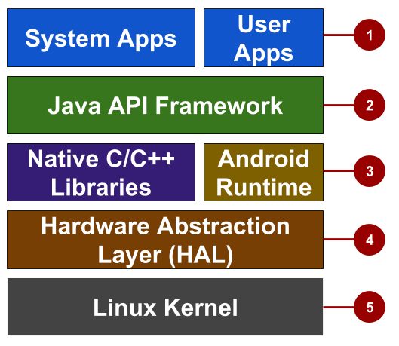
Android Architecture
Notes:
Android is an OS stack, consists of different layers.
1. Apps: Your apps live at this level, along with core system apps for email, SMS messaging, calendars, internet browsing, and contacts.
2. Java API framework: All features for Android development, such as UI components, resource management, and lifecycle management, are available through application programming interfaces (APIs). You don't need to know the details of how the APIs work. You only need to learn how to use them.
3. Libraries and Android runtime: Each app runs in its own process, with its own instance of the Android runtime. Android includes a set of core runtime libraries that provide most of the functionality of the Java programming language. Many core Android system components and services are built from native code that require native libraries written in C and C++. These native libraries are available to apps through the Java API framework.
Hardware abstraction layer (HAL): This layer provides standard interfaces that expose device hardware capabilities to the higher-level Java API framework. The HAL consists of multiple library modules, each of which implements an interface for a specific type of hardware component, such as the camera or Bluetooth module.
Linux kernel: The foundation of the Android platform is the Linux kernel. The layers above the Linux kernel rely on the Linux kernel for threading, low-level memory management, and other underlying functionality. Using a Linux kernel enables Android to take advantage of Linux-based security features and allows device manufacturers to develop hardware drivers for a well-known kernel.

Slide 19
The challenges of Android app development
While the Android platform provides rich functionality for app development, there are still a number of challenges you need to address, such as:
Building for a multiscreen world
Getting performance right
Keeping your code and your users more secure
Making sure your app is compatible with older platform versions
Understanding the market and the user
Notes:
- Building for a multi-screen world
Android runs on billions of handheld devices around the world and supports various form factors including wearable devices and televisions. Devices come in different sizes and shapes, which affects how you design the screens and UI elements in your apps.
In addition, device manufacturers may add their own UI elements, styles, and colors to differentiate their products. Each manufacturer offers different features with respect to keyboard forms, screen size, or camera buttons. An app running on one device may look a bit different on another. Your challenge, as a developer, is to design UI elements that work on all devices.
- Maximizing app performance
An app's performance is determined by how fast it runs, how easily it connects to the network, and how well it manages battery and memory usage. Performance is affected by factors such as battery life, multimedia content, and internet access. Be aware that some features you design for your app may cause performance problems for users. For example, to save the user's battery power, enable background services only when they are necessary.
- Keeping your code and your users more secure
You need to take precautions to make your code, and the user's experience when they use your app, as secure as possible.
Use tools such as ProGuard, which is provided in Android Studio. ProGuard detects and removes unused classes, fields, methods, and attributes.
Encrypt all of your app's code and resources while packaging the app.
To protect critical user information such as logins and passwords, secure your communication channel to protect data in transit across the internet, as well as data at rest on the device
- Remaining compatible with older versions of Android
The Android platform continues to improve and provide new features you can add to your apps. However, you should ensure that your app can still run on devices with older versions of Android. It is impractical to focus only on the most recent Android version, as not all users may have upgraded or may be able to upgrade their devices. Fortunately Android Studio provides options for developers to more easily remain compatible with older versions.

Slide 20
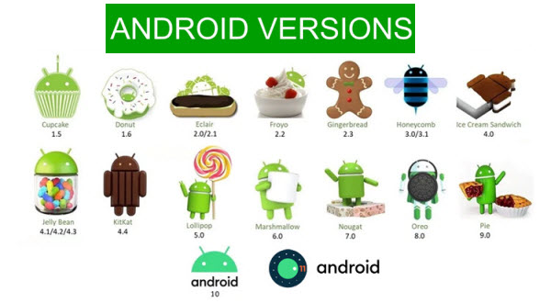
Android Version History

